Slide 1


YOUR STORM RESPONSE PARTNER

Slide 2


Ladder Safety
OSHA estimates that there are more than 24,000 injuries and as many as 36 fatalities per year due to falls from stairways and ladders used in construction.
OSHA Standard 29 CFR 1926.1053 was written for the construction industry, but the standard should be applied to all ladder use.

Slide 3
Ask these questions before deciding on a ladder
Will heavy items be held while on the ladder?
Does the elevated area require a long ladder that can be unstable?
Will work be performed at this height over an extended period of time?
Will working on a ladder require standing or reaching?
Are there any obstructions preventing safe ladder use?
If the answer to any of these questions is “Yes,” then you may need to consider using something other than a ladder. If possible, bring in other equipment such as a scissor lift or scaffolding.

Slide 4
Plan Ahead to Get the Job Done Safely
Follow the manufacturer’s instructions and labels on the ladder. To determine the correct ladder, consider your weight plus the weight of your load.
Do not exceed the load rating and always include the weight of all tools, materials and equipment.

Slide 5
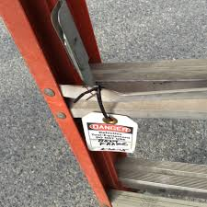
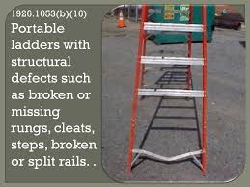
Ladder Inspection
A competent person must visually inspect all extension ladders before use for any defects such as: missing rungs, bolts, cleats, screws and loose components.
Where a ladder has these or other defects, it must be immediately marked as defective or tagged with “Do Not Use” or similar language.

Slide 6

Preparing for Installation
Allow sufficient room to step off the ladder safely. Keep the area around the bottom and the top of the ladder clear of equipment, materials and tools.
If access is obstructed, secure the top of the ladder to a rigid support that will not deflect, and add a grasping device to allow workers safe access.

Slide 7
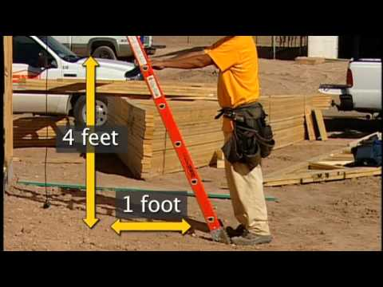
Determining Installation Angle
A non-self-supporting ladder should have a set-up angle of about 75 degrees – a 4:1 ratio of the ladder’s working length to set-back distance.
Here’s how to achieve it: Stand at the base of the ladder with your toes touching the rails. Extend your arms straight out in front of you. If the tips of your finger just touch the rung nearest your shoulder level, the angle of your ladder has a 4:1 ratio.

Slide 8


Determining the Proper Height
For access to an elevated work surface, extend the top of the ladder three feet above that surface or secure the ladder at its top.

Slide 9
Recognizing Electrical Hazards
Before starting work, survey the area for potential hazards, such as energized overhead power lines.
Ladders shall have nonconductive side rails if they are used where the worker or the ladder could contact exposed energized electrical equipment.
Keep all ladders and other tools at least 10 feet away from any power lines.

Slide 10
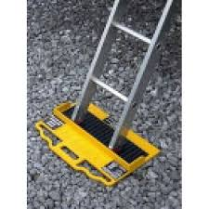
Installation Continued
Set the base of the ladder so that the bottom sits securely and so both side rails are evenly supported.
The ladder rails should be square to the structure against which it is leaning with both footpads placed securely on a stable and level surface

Slide 11
Ladder Movement Prevention
When using a ladder in a high-activity area, secure it to prevent movement and use a barrier to redirect workers and equipment.
If the ladder is placed in front of a door, always block off the door

Slide 12

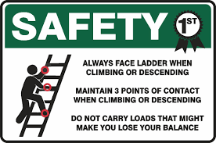
Safe Ladder Use—DO:

Slide 13
Safe Ladder Use—DO:
Carry tools in a tool belt or raise tools up using a hand line.
Never carry tools in your hands while climbing up/down a ladder.
Extend the top of the ladder three feet above the landing.
Keep ladders free of any slippery materials.

Slide 14
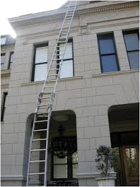
Safe Ladder Use—DO Not:
Place a ladder on boxes, barrels, or unstable bases.
Exceed the ladder’s maximum load rating.
Tie two ladders together to make them longer.

Slide 15
Safe Ladder Use—DO Not:
Ignore nearby overhead power lines.
Move or shift a ladder with a person or equipment on the ladder.
Lean out beyond the ladder’s side rails.
Use an extension ladder horizontally like a platform.

