Slide 1
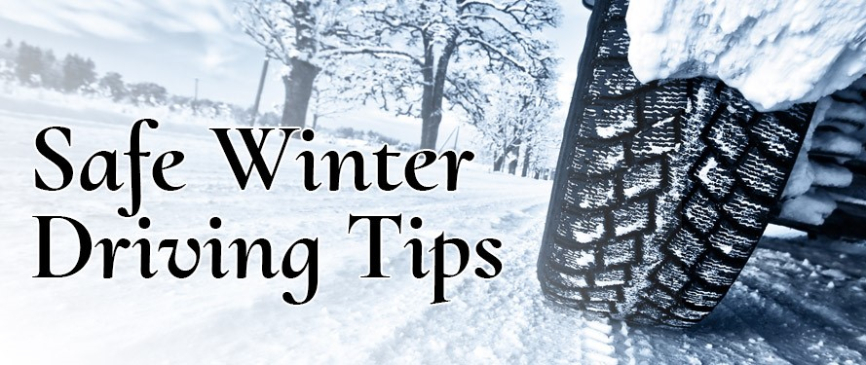

Slide 2
WINTER WEATHER PREPERATIONS
Wipers - Good working order
Ice Scraper - A necessity
Windshield Washer Fluid - Fill Up
Anti-freeze - 50% water 50% Coolant
Battery & Belts - Check condition
Tires - Check treads, pressure and owners manual recommendations (Seasonal)

Slide 3
BEFORE TRIPS:
PACK A WINTER CAR KIT
Snow brush w/ scraper
Flashlight w/ batteries
Blanket
Mittens, socks & hat
Small shovel
Jumper cables
Hazard sign, flares or flag
Windshield washer fluid

Slide 4
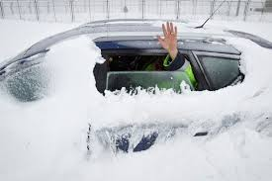
Warm Up & Clean Off
Idle the engine – do not race it.
Clean off the vehicle completely.
Clean all light lenses.
Scrape all windows and mirrors clear.
Good all-round visibility is important.
Remember – being in a hurry now may result in an accident down the road.

Slide 5
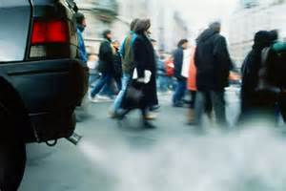
Carbon Monoxide
Each year 1,500 people are killed in the U.S. by carbon monoxide.
More than 10,000 are exposed to levels so
dangerous that medical attention is required.

Slide 6
Carbon Monoxide, cont.
Carbon Monoxide is Odorless & Colorless
First signs include Nausea, Headache, Dizziness
It Causes Drowsiness
Automatic starters can cause a build-up before
you get into the car.

Slide 7
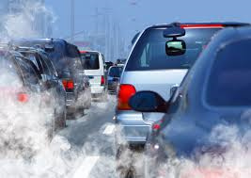
Carbon Monoxide Prevention
Never run the vehicle in a closed area, i.e., your garage.
Have your exhaust system checked for leaks.

Slide 8
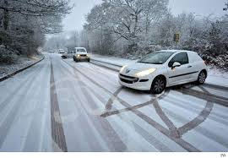
If you skid
Skidding can occur for a variety of reasons:
Black ice
Driving too fast for conditions
Sudden acceleration
Sudden steering corrections
Braking

Slide 9
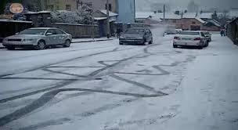
If you skid, cont.
If your vehicle begins to skid, take the follow actions:
Front end skid – release the brake and let the front wheels roll freely to regain traction and steering control.
Rear end skid – take your foot off the accelerator and turn in the direction that the rear of the vehicle is skidding, pump the brakes slightly.

Slide 10
Black Ice
Black ice is especially dangerous because you can’t see it.
Areas where you commonly encounter it include:
  Bridges
  Overpasses
  Underpasses
  Shaded areas

Slide 11
Black Ice, cont.
If you encounter black ice:
Don’t panic.
Make no sudden changes in direction or speed.
Ease off the accelerator.
Gradually steer in the direction that the rear of the vehicle is skidding.

Slide 12
Winter Driving Tips
Driving at reduced speeds enables you to stop quicker.
Activate turn signals sooner than usual. This give other drivers more time to react.
Touch your brake pedal to warn other drivers of your intention to slow or stop.
Maintain at least triple the normal distance from the vehicle in front of you.
Keep your gas tank at least half full.

Slide 13

Summary
Be prepared before a trip.
Allow for more time to travel.
Look well ahead of you.
Be aware of carbon monoxide
Be cautious of black ice.
Always wear your seat belts!

